Slide 1


Erik Tran
3 March 2024

Slide 2

Outline
Executive Summary
Introduction
Methodology
Results
Conclusion
Appendix

Slide 3
Executive Summary
The goal was to build a model to predict if the first stage of a given Falcon 9 rocket launch would successfully land in order to determine cost of launch.
Data from publically available SpaceX Falcon 9 historical launches was collected, wrangled, explored and fitted using various Python sklearn machine learning classification models.
The final selected model performs well to predict successful launches. However the model tends to be optimistic on successful launches, resulting in false positives. Accuracy score 0.83

Slide 4
Introduction
Our goal is to predict if the SpaceX Falcon 9 first stage will land successfully. SpaceX advertises Falcon 9 rocket launches on its website with a cost of 62 million dollars; other providers cost upward of 165 million dollars each, much of the savings is because SpaceX can reuse the first stage. Therefore if we can determine if the first stage will land, we can determine the cost of a launch. This information can be used if an alternate company wants to bid against SpaceX for a rocket launch.
The main question that we are trying to answer is, for a given set of features about a Falcon 9 rocket launch which include its payload mass, orbit type, launch site, and so on, will the first stage of the rocket land successfully?

Slide 5

Section 1

Slide 6
Methodology
Executive Summary
Data collection methodology:
Webscrape launch data from SpaceX website & Wikipedia
Perform data wrangling
Clean up data to focus on whether the booster successfully landed or not
Perform exploratory data analysis (EDA) using visualization and SQL
Perform interactive visual analytics using Folium and Plotly Dash
Perform predictive analysis using classification models
Standardised data, perform GridSearchCV to determine best parameters for various classification models: Log regression, SVM, Decision tree, K-Nearest Neighbours

Slide 7
Data Collection
Data collected from following sources:
SpaceX API of past launches (URL: https://api.spacexdata.com/v4/launches/past)
Webscraping SpaceX Falcon 9 and Falcon Heavy historical launch data from Wikipedia (URL: https://en.wikipedia.org/wiki/List_of_Falcon_9_and_Falcon_Heavy_launches)

Slide 8
Data Collection – SpaceX API
Request and parse the SpaceX launch data using the GET request
Filter the dataframe to only include Falcon 9 launches
Dealing with Missing Values:
Payload Mass: Replace NaN with Mean
Github URL: https://github.com/ektran2002/IBMdatascience/blob/347d09f03f4f5c03dab7107dad8912ca0f4e1e6c/jupyter-labs-spacex-data-collection-api.ipynb

Slide 9
Data Collection - Scraping
Request the Falcon9 Launch Wiki page from its URL
Extract all column/variable names from the HTML table header
Create a data frame by parsing the launch HTML tables
Github URL: https://github.com/ektran2002/IBMdatascience/blob/347d09f03f4f5c03dab7107dad8912ca0f4e1e6c/jupyter-labs-webscraping.ipynb

Slide 10
Data Wrangling
Calculate the number of launches on each site
Calculate the number and occurrence of each orbit
Calculate the number and occurence of mission outcome of the orbits:
1: First stage successfully landed
0: First stage landing was unsuccessful
Github URL: https://github.com/ektran2002/IBMdatascience/blob/347d09f03f4f5c03dab7107dad8912ca0f4e1e6c/labs-jupyter-spacex-Data%20wrangling.ipynb

Slide 11
EDA with Data Visualization
Scatter plot: Outcome class vs Flight Number & Launch Site
Scatter plot: Outcome class vs Payload and Launch Site
Bar plot: Outcome vs Orbit
Cat plot: Outcome class vs Flight Number and Orbit
Line plot: Success rate vs Year
Github URL: https://github.com/ektran2002/IBMdatascience/blob/347d09f03f4f5c03dab7107dad8912ca0f4e1e6c/jupyter-labs-eda-dataviz.ipynb.jupyterlite.ipynb

Slide 12
EDA with SQL
Display the names of the unique launch sites in the space mission | select distinct Launch_Site from SPACEXTABLE
Display 5 records where launch sites begin with the string 'CCA' | select * from SPACEXTABLE where Launch_Site like "CCA%" limit 5
Display the total payload mass carried by boosters launched by NASA (CRS) | select sum(PAYLOAD_MASS__KG_) from SPACEXTABLE where Customer == "NASA (CRS)“
Display average payload mass carried by booster version F9 v1.1 | select avg(PAYLOAD_MASS__KG_) from SPACEXTABLE where Booster_Version like "F9 v1.1%"
List the date when the first succesful landing outcome in ground pad was acheived. | select min(Date) from SPACEXTABLE where Landing_Outcome == "Success (ground pad)"
List the names of the boosters which have success in drone ship and have payload mass greater than 4000 but less than 6000 | select distinct Booster_Version from SPACEXTABLE where Landing_Outcome == "Success (drone ship)" and PAYLOAD_MASS__KG_ > 4000 and PAYLOAD_MASS__KG_ < 6000
List the total number of successful and failure mission outcomes | select Mission_Outcome, count(*) from SPACEXTABLE group by Mission_Outcome
List the names of the booster_versions which have carried the maximum payload mass. Use a subquery | select Booster_Version, PAYLOAD_MASS__KG_ from SPACEXTABLE where PAYLOAD_MASS__KG_ == (select max(PAYLOAD_MASS__KG_) from SPACEXTABLE)
List the records which will display the month names, failure landing_outcomes in drone ship ,booster versions, launch_site for the months in year 2015. | select substr(Date,0,5) as year, substr(Date, 6,2) as month, Booster_Version, Launch_Site, Landing_Outcome from SPACEXTABLE where Landing_Outcome == "Failure (drone ship)" and substr(Date,0,5)='2015'
Rank the count of landing outcomes (such as Failure (drone ship) or Success (ground pad)) between the date 2010-06-04 and 2017-03-20, in descending order. | select Landing_Outcome, count(*) from SPACEXTABLE group by Landing_Outcome order by count(*) desc
Github URL: https://github.com/ektran2002/IBMdatascience/blob/cec52c827b465d31c1d9b38b348d381f8a560804/jupyter-labs-eda-sql-coursera_sqllite.ipynb

Slide 13
Build an Interactive Map with Folium
TASK 1: Mark all launch sites on a map using Circle for Launch Site
TASK 2: Mark the success/failed launches for each site on the map using Green Marker for Success and Red Marker for failed
TASK 3: Calculate the distances between a launch site to its proximities using Polyline to indicate distance to nearest City, Highway, Rail and Coast
Github URL: https://github.com/ektran2002/IBMdatascience/blob/347d09f03f4f5c03dab7107dad8912ca0f4e1e6c/lab_jupyter_launch_site_location.jupyterlite.ipynb

Slide 14
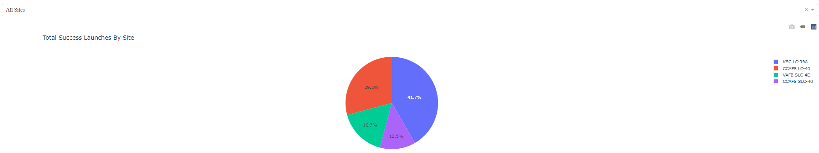
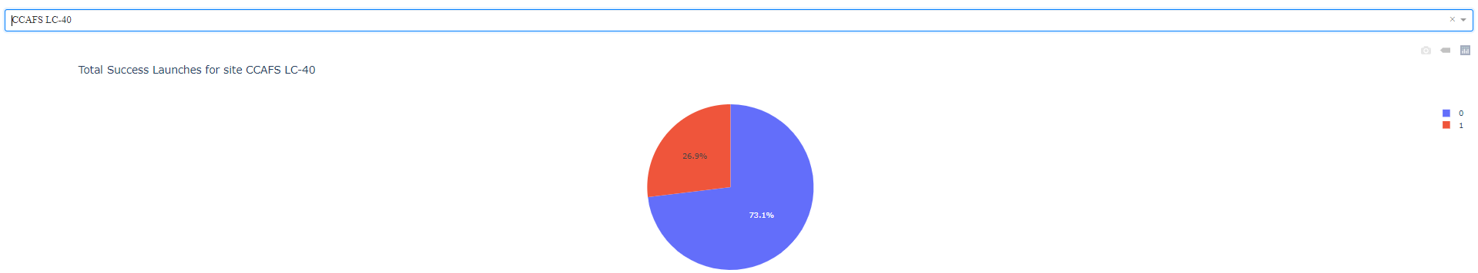
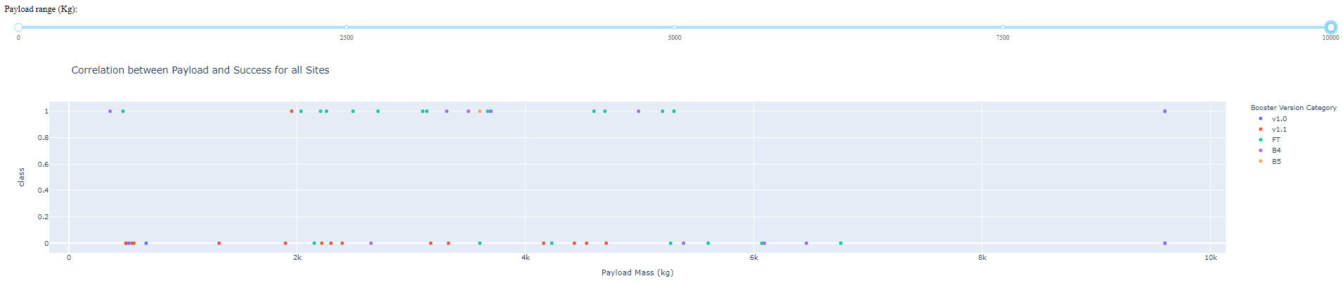
Build a Dashboard with Plotly Dash
Github URL: https://github.com/ektran2002/IBMdatascience/blob/10a94197f4dbdd73b330584f4e09f07b577a948e/%5B7%5D%20spacex%20dash%20app.py

Slide 15
Predictive Analysis (Classification)
Assign Outcome Class to variable Y
StandardScaler fit to standardise data as X
Split into training and test datasets using train_test_split
Using Train data, Fit and find the best parameters using GridSearchCV for the following classifiers:
- Log regression
- SVM
- Decision Tree
- KNN
For each classifier, calculate accuracy score of the fit for Test data and visual with Confusion Matrix
Determine best classifier based on accuracy score
Github URL: https://github.com/ektran2002/IBMdatascience/blob/347d09f03f4f5c03dab7107dad8912ca0f4e1e6c/SpaceX_Machine_Learning_Prediction_Part_5.jupyterlite.ipynb

Slide 16
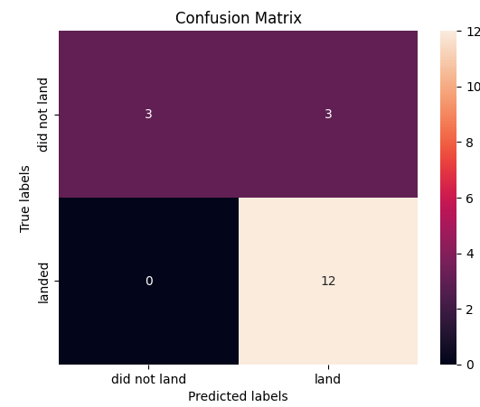
Results
Exploratory data analysis results:
as the flight number increases, the first stage is more likely to land successfully.
the more massive the payload, the less likely the first stage will return.
different launch sites have different success rates. CCAFS LC-40, has a success rate of 60 %, while KSC LC-39A and VAFB SLC 4E has a success rate of 77%.
for the VAFB-SLC launchsite there are no rockets launched for heavypayload mass(greater than 10000)
ES-L1, SSO, HEO, GEO orbits have the highest success rate (100% success)
LEO orbit the Success appears related to the number of flights; on the other hand, there seems to be no relationship between flight number when in GTO orbit
heavy payloads the successful landing or positive landing rate are more for Polar,LEO and ISSHowever for GTO we cannot distinguish this well as both positive landing rate and negative landing(unsuccessful mission) are both there here.
sucess rate since 2013 kept increasing till 2020
Interactive analytics demo in screenshots
Predictive analysis results:
All classifier methods (Log regression, SVM, Decision tree, KNN) gave equal score and predictions, therefore all performed equally

Slide 17

Section 2

Slide 18
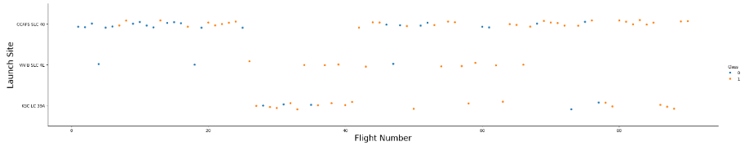
Flight Number vs. Launch Site
CCAFS LC-40 was the first launch site and the most frequent
No recent launches at VAFB-SLC 4E
KSC LC-39A launches started later

Slide 19
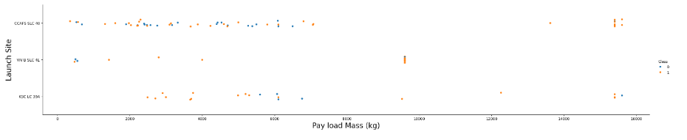
Payload vs. Launch Site
VAFB-SLC launchsite there are no rockets launched for heavypayload mass(greater than 10000)

Slide 20
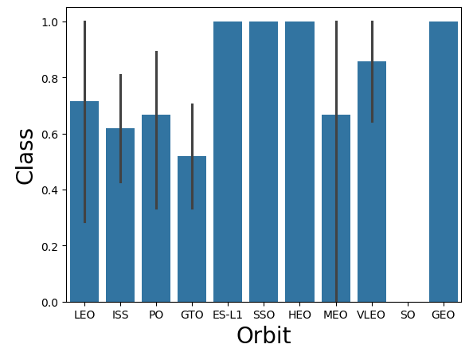
Success Rate vs. Orbit Type
ES-L1, SSO, HEO, GEO has the highest (perfect) success rate
GTO has the lowest success rate ~50%

Slide 21
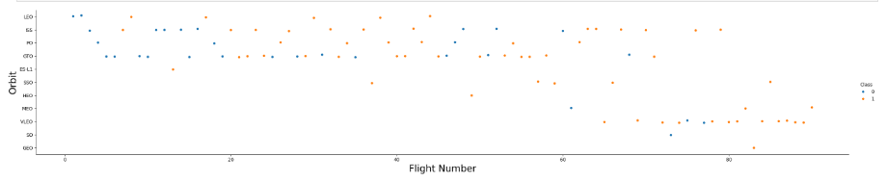
Flight Number vs. Orbit Type
in the LEO orbit the Success appears related to the number of flights; on the other hand, there seems to be no relationship between flight number when in GTO orbit

Slide 22
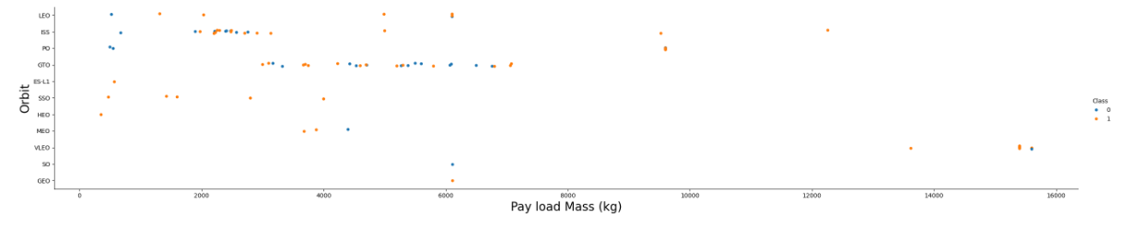
Payload vs. Orbit Type
heavy payloads the successful landing or positive landing rate are more for Polar,LEO and ISS.
However for GTO we cannot distinguish this well as both positive landing rate and negative landing(unsuccessful mission) are both there here

Slide 23
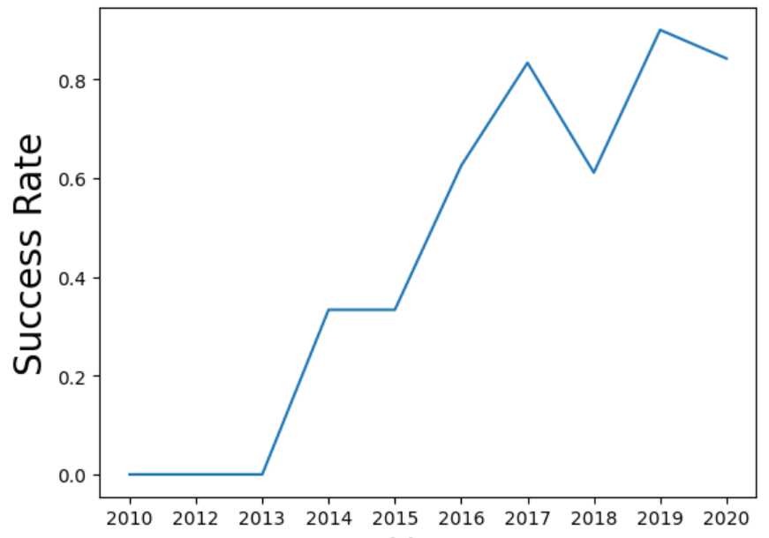
Launch Success Yearly Trend
sucess rate since 2013 kept increasing till 2020

Slide 24
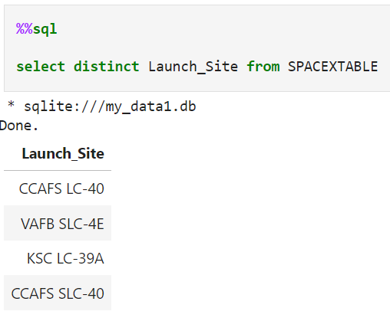
All Launch Site Names

Slide 25
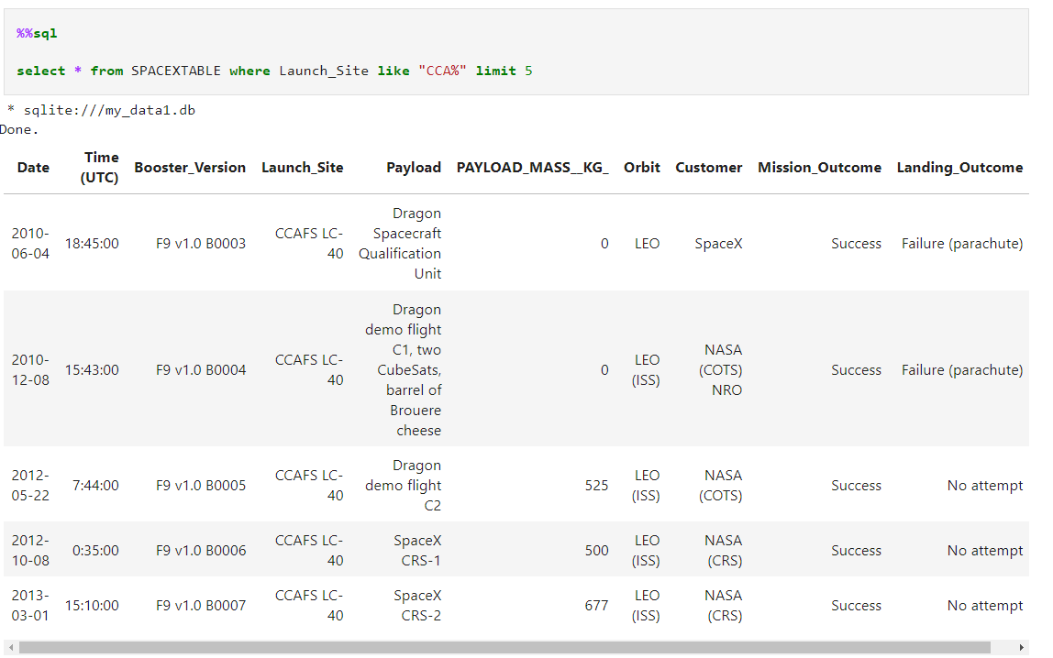
Launch Site Names Begin with 'CCA'

Slide 26
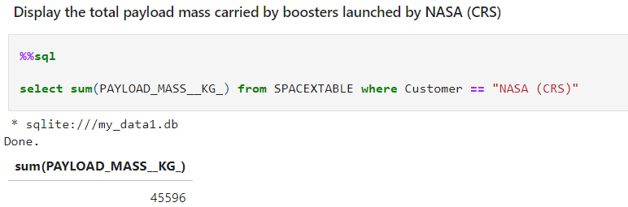
Total Payload Mass

Slide 27
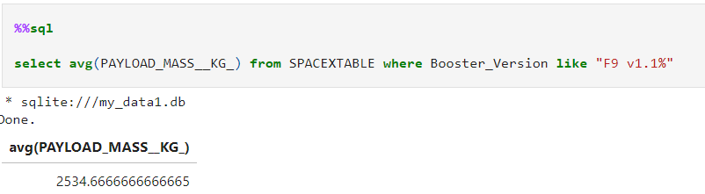
Average Payload Mass by F9 v1.1
Calculate the average payload mass carried by booster version F9 v1.1

Slide 28
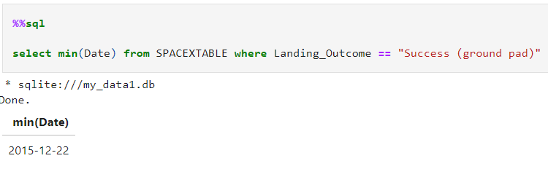
First Successful Ground Landing Date
Find the dates of the first successful landing outcome on ground pad

Slide 29
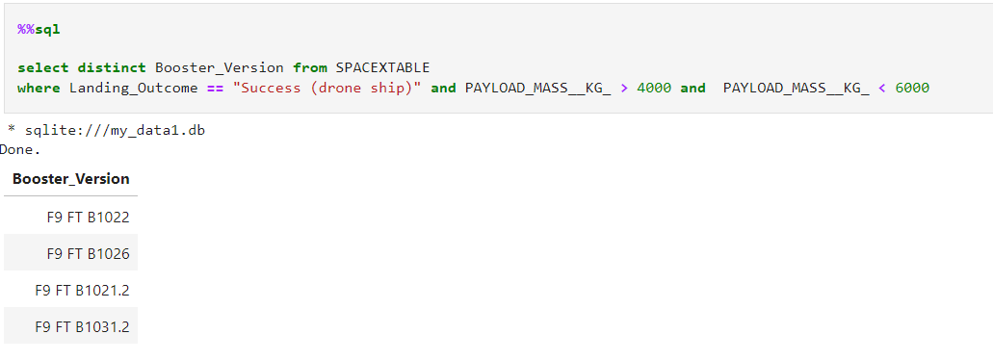
Successful Drone Ship Landing with Payload between 4000 and 6000
List the names of boosters which have successfully landed on drone ship and had payload mass greater than 4000 but less than 6000

Slide 30
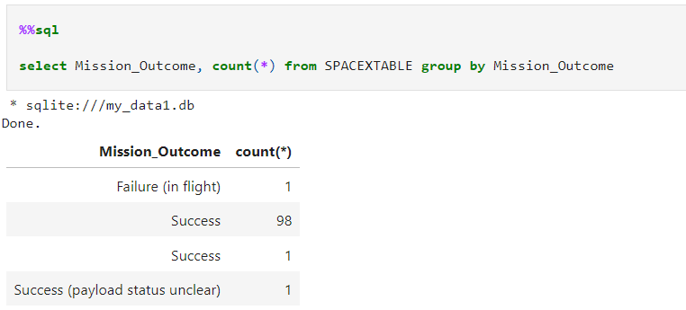
Total Number of Successful and Failure Mission Outcomes
Calculate the total number of successful and failure mission outcomes

Slide 31
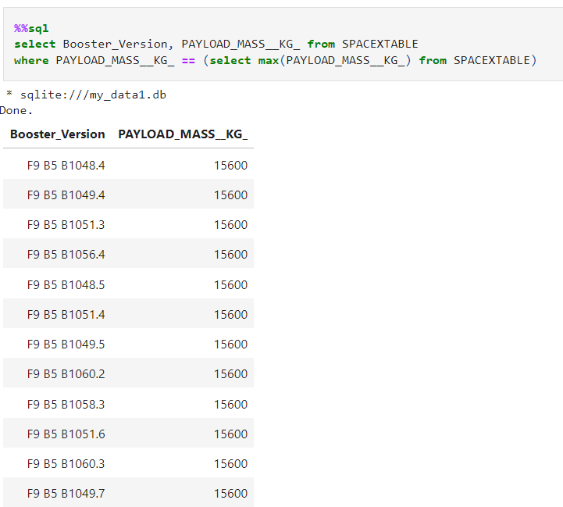
Boosters Carried Maximum Payload
List the names of the booster which have carried the maximum payload mass

Slide 32
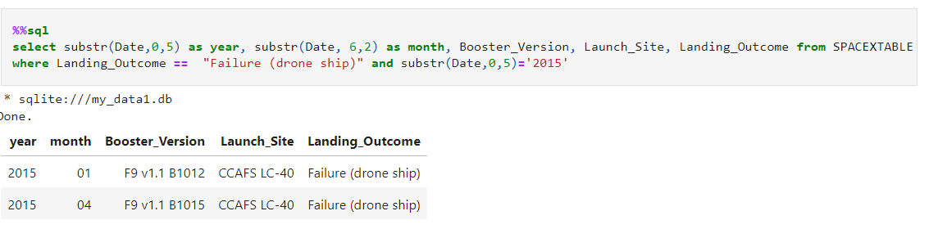
2015 Launch Records
List the failed landing_outcomes in drone ship, their booster versions, and launch site names for in year 2015

Slide 33
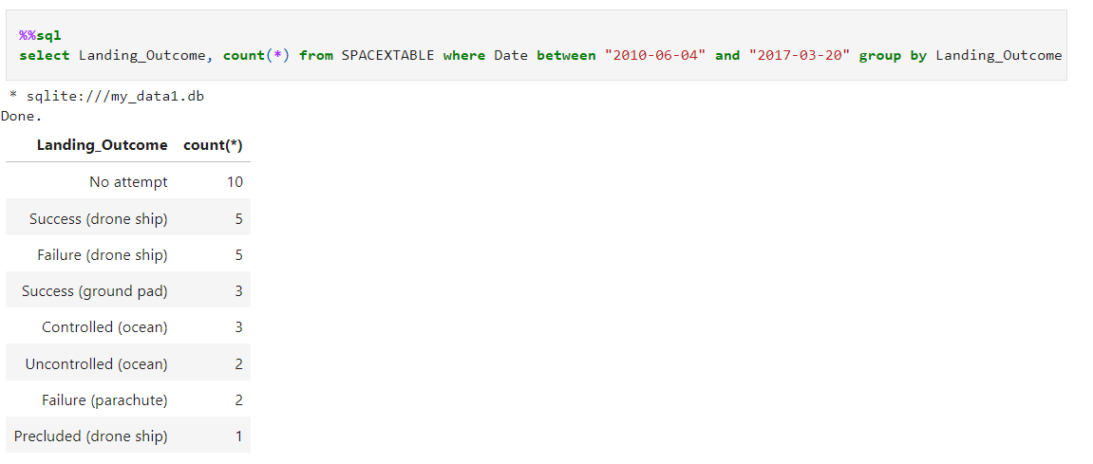
Rank Landing Outcomes Between 2010-06-04 and 2017-03-20
Rank the count of landing outcomes (such as Failure (drone ship) or Success (ground pad)) between the date 2010-06-04 and 2017-03-20, in descending order

Slide 34

Section 3

Slide 35
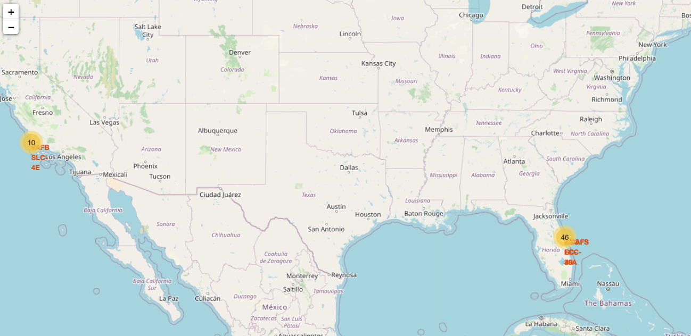
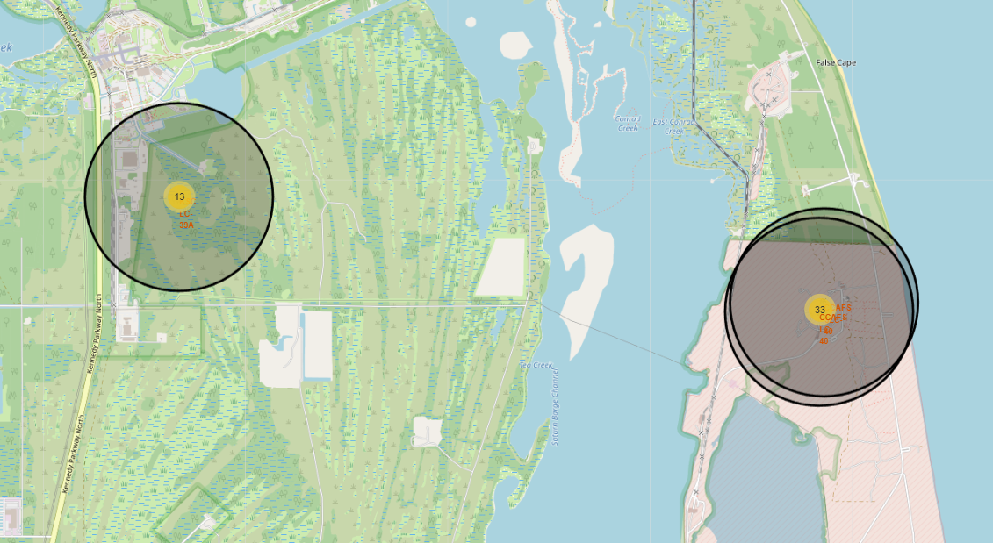
Map: Launch Sites

Slide 36
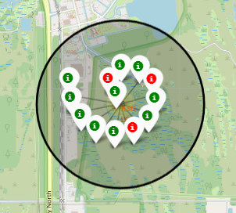
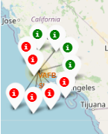
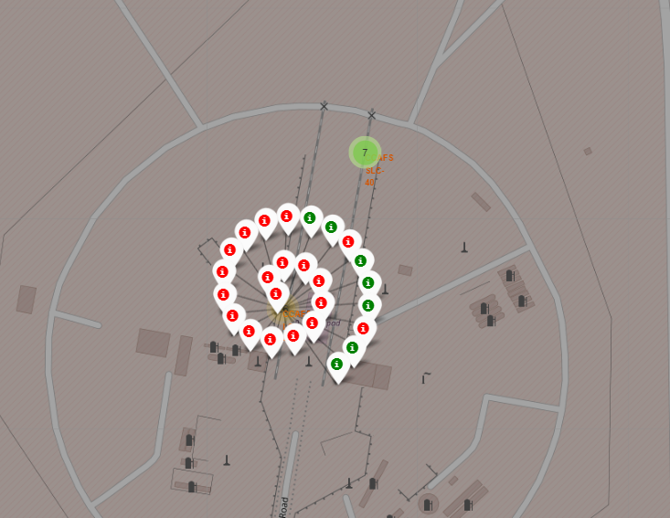
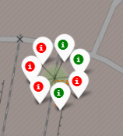
Launch Outcome per Site

Slide 37
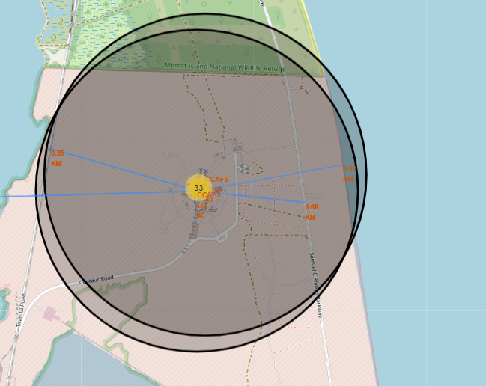
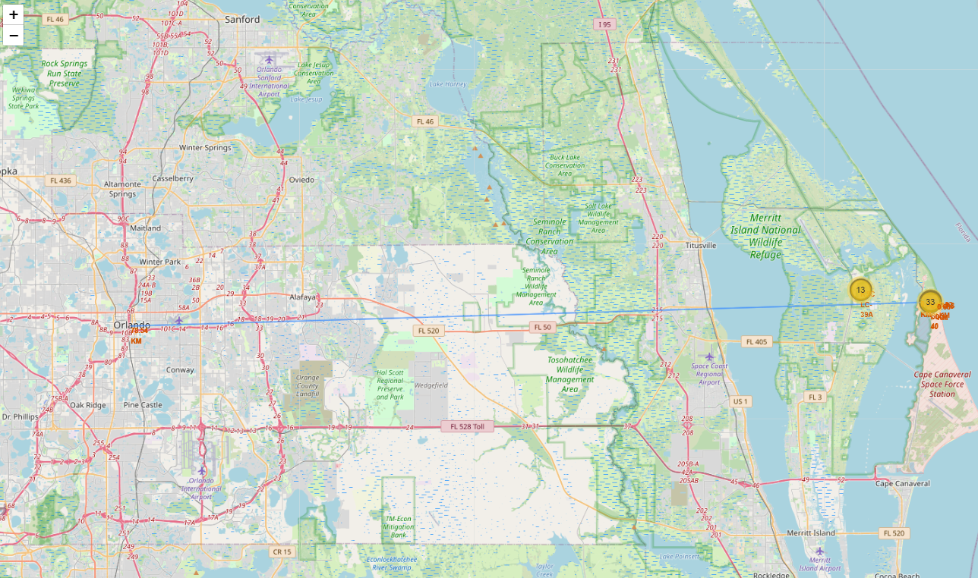
CCAFS LC-40 proximity to cities, highways, coast, rail

Slide 38

Section 4

Slide 39
Successful stage 1 landing for all sites

Slide 40
Success vs Failed stage 1 landings per site
For example, CCAFS LC-40 Launch site:

Slide 41
Payload vs. Launch Outcome scatter plot for all sites

Slide 42

Section 5

Slide 43
Classification Accuracy
All 4 classification models had the same accuracy score 0.833, therefore can conclude that all models perform equally and any can be selected as the final model.

Slide 44
Confusion Matrix
All models had the same confusion matrix
The models correctly predicted all landed (successful flights)
The models tends to be optimistic in predicting successful flights and results in false positives (predicted successful flights which actually failed)

Slide 45
Conclusions
The final model performs well to predict successful launches
However the model tends to be optimistic on successful launches, resulting in false positives. Accuracy score 0.83

Slide 46


